Slide 1
Experiential Learning at DelVal:
The Experience360 Program
September 22, 2023
Notes:
Thank you.
Will work through each section and then pause for questions and comments.

Slide 2
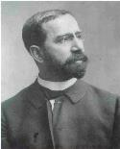
Our Founding and DelVal Today
The National Farm School founder by Rabbi Joseph Krauskopf
  a 100-acre farm in Doylestown, PA, a small classroom building, two faculty and six students
Krauskopf spent time with Leo Tolstoy, who advised him to return to America and “lead the tens of thousands from your congested cities to your idle, fertile lands…”
Delaware Valley University
  Small, private university with approximately 1,600 undergraduates and 1,100 acres of land.
Rabbi Krauskopf

Slide 3
The Value Proposition of Higher Education
Quality Education and Life after college
  "in almost every college or university's vision statement, there are two related components that constitute its mission. One calls for providing a quality education to its students, while the other focuses on students' preparation for life after college" (Chan & Derry, 2013, p. 28).
Internships as an integral part of higher education
  Council for the Advancement of Standards in Higher Education

Slide 4
Experiential Education
Dewey – education and experience to foster learning.
Freire – students and teachers as learners in problem-posing education.
Kolb – Experiential Learning Theory
  "learning is the process whereby knowledge is created through the transformation of experience" (Kolb, 1984, p. 38).
Sweitzer and King – Development Stages of an internship
  “the pedagogy of internships, drawn from the pedagogy of experiential education, requires an engaged stance as students actively reflect on their experiences and draw conclusions” (Sweitzer and King, 2013, p. 60).

Slide 5
Experiential Learning Theory
A cyclical four stage process that moves a student though concrete experience to reflective observation to abstract conceptualization to active experimentation (Bergsteiner & Avery, 2014).
Identifies four learning styles: converger, diverger, assimilator, and accommodator (Collins & Roberts, 2012).
The learning styles can inform how a student may experience and interact with different environments. (Kolb, 1984).
Notes:
The cyclical nature proposes that once a student has moved to active experimentation, the student returns to concrete experience and repeats the experiential learning cycle (Stage & Hubbard, 2018).

Slide 6
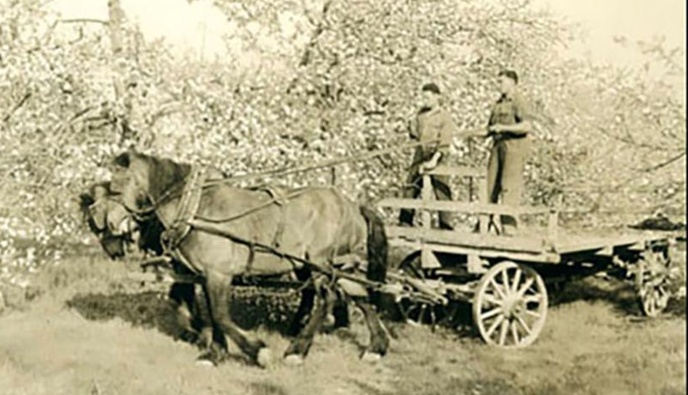

Founding Ethos
  Science with Practice
  Always part of a DelVal education
Employment Program
  Completing 400 hours before graduation
  Limited oversight and coordination
Experience360 Program
  Learning by Doing
  Based on completing at least 2 Activities embedded in the student’s academic program

Slide 7

The Experience360 (E360) program
  Program launch in Fall 2012
    Four-year pilot
    First graduates in the Class of 2016
  Graduation requirement for all undergraduate students
  Greater focus on student development of knowledge and skills
  Real time reflection in course
  Part of their learning as a student from day one…
    DelVal Experience I and DelVal Experience II

Slide 8
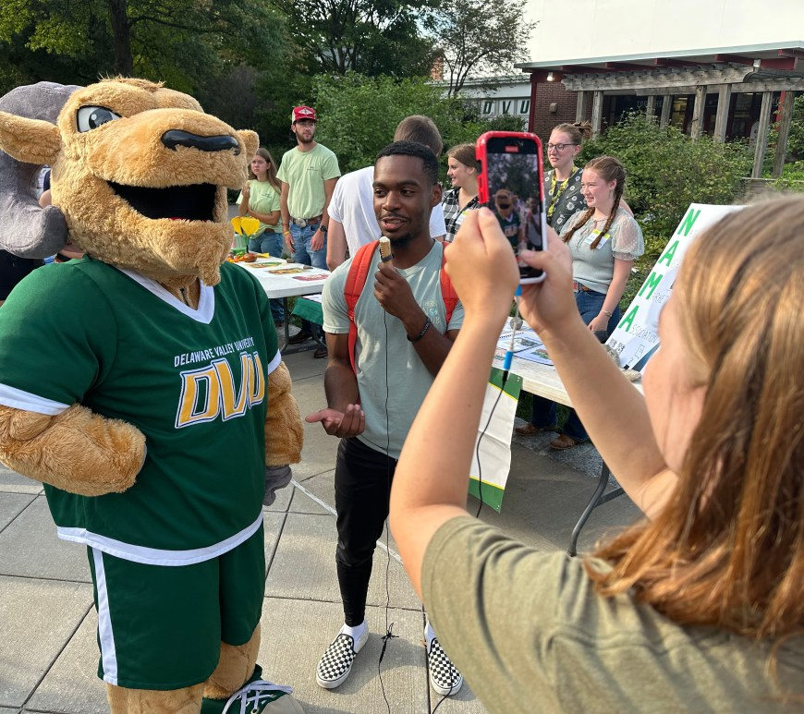
DelVal Experience II
Part of the Core Curriculum
Pre-requisite for the E360 Program
Problem Based Learning to explore…
  Career Exploration
  Professional Development
  Ongoing Transition Support
  Campus Engagement
  E360 Program Structure
    Repetition, repetition, repetition…
Full360 Student Blog at
the Club & Org Expo

Slide 9
The Experience360 Program (E360)
Program Scheme
Student developed learning objectives for their activity
E360 Staff Review
Site Supervisor Review
Department Chair Review
Student is at site and enrolled in an online course
  Online course supports real time reflection about the experience at the site
Completion of Hours and Passing Course to complete activity
  A student needs to complete the hours and pass the course to successfully complete the activity

Slide 10
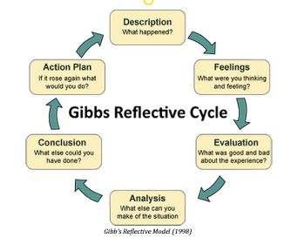
E360 Program Outcomes & Learning Outcomes
Skill Development
Articulation of Learning
Student Learning Objectives
Student Self-Evaluation
Site Supervisor Evaluation

Slide 11
E360 Activities
Academic Internship
Career Exploration Experiences
Leadership Development
Community Service
Civic Engagement
Student Research
Study Abroad

Slide 12
The Experience360 Program (E360):Outcomes
Class Year | Career Outcomes Rate
Class of 2014 | 88.3%
Class of 2015 | 87.7%
Class of 2016 | 90.7%
Class of 2017 | 91.2%
Class of 2018 | 93.2%
Class of 2019 | 94.4%
Class of 2020 | 91.5%
Class of 2021 | 89.1%
Class of 2022 | 94.4%

Slide 13
What’s next for E360?
Clearly outlined and articulated program outcomes and program expectations
  Institutions and employers should explicitly state to students what learning can or may occur due to academic internship participation
Every student should has access to the experience
  Implementing practices that make internships more accessible (Paid/Unpaid)
  Providing at least a satisfactory experience for every student who engages in an internship
Expanding Partnerships with Industry and Community
  Examples: Mountaire Farms; URBN and Terrain; Doylestown Health

Slide 14
But how do we know?
The Value Proposition of Higher Education
  Experiential Education
    Internships as part of the Value Proposition
      Acquisition of Skills, Competencies and Knowledge as a result of Internships
        Graduate Preparedness and Competency Development
        Communication, Critical Thinking, and Professionalism

Slide 15
Background
National Survey of College Internships (NCSI) 2021 Report from the Center for Research on College-Workforce Transitions.
Highlights many variables that need further research to inform understanding of internships.
Four skills reviewed by the NCSI were: communication, problem-solving, supervising others, and teamwork.
While the pilot has many takeaways, a takeaway for this study was that 1 in 4 students reported an internship experience that was less than satisfactory (Hora, Colston, Chen, & Pasqualone, 2021).
Notes:
The NCSI studied various topics related to internships, including the number of students participating in an internship, internship participation by demographic factors like race and gender, and the format of the internship experience. The NCSI was a pilot study with 17 participating higher education institutions. The research site for this study participated in the NSCI pilot study.
The study found that students had the most opportunities to develop the skills of communication and problem-solving.
The authors also note that in future iterations of the NSCI, the skills will be reviewed and aligned with the NACE competencies. This alignment is being done to “capture student perceptions on the degree of growth in these competencies that can be attributed to the internship experience”
THIS sparked more of my interest – DelVal was part of this. This connects to NACE which is the industry standard

Slide 16
Internships as part of the Value Proposition
High Impact Practice – assorted Kuh and Kuh et al. research
Themes of accessing an internship, program factors, and institutional design are being studied to determine how institutions provide an equitable experience to every student who engages with an internship program (Hora & Chen, 2020)
Some benefits related to the student experience are: greater insight about the industry, clarity on personnel and career goals, and the possibility for advancement in the company after the internship experience (Coco, 2000)
Notes:
Every student in the study has participated in an internship
The high impact practice, the experience, and the benefits of the experience – these can be explored in reviewing the artefact data and in interviewing the participants
Yet
This ties back to the idea that one in four have a negative experience as well
So while there is a great deal known about internships broadly, there is a great deal of nuance to add

Slide 17
Internships are part of a critical phase in students’ psychological and professional development. Understanding how they are interpreting these experiences can provide valuable information for appropriate, positive, and effective program creation.
Center for Research on College-Workforce Transitions, 2019, p. 3

Slide 18
Graduate Preparedness and Competency Development
The Internship
Professionalism
Communication
Critical Thinking
A Prepared Graduate?
Communication
Critical Thinking
Professionalism
Notes:
NACE and why these three – greatest difference; greater than 40%
Employer perspective, student perspective, institution perspective
Communication – a wide array of skills - verbal, oral, listening skills
professionally, clearly and concisely - Coffelt, Grauman, and Smith
Critical Thinking – portfolio and ExLP to increase critical thinking; may be relevant to coursework at research site
Professionalism – broad term; research on employability and pre-professional identity development
career adaptability as "readiness to cope with the predictable tasks of preparing for and participating in the work role and with the unpredictable adjustment prompted by changes in the and working conditions" (Ocampo, et al., 2020, p. 2; Ocampo, et al., 2020)

Slide 19
Methodology
Descriptive Qualitative Single Case Study
A qualitative research method allows the researcher to understand the meaning of the experience for those involved (Creswell, 2007).
A case study is “an empirical inquiry that investigates a contemporary phenomenon (the ‘case’) in depth and within its real-world context, especially when the boundaries between phenomenon and context may not be clearly evident.” (Yin, 2014, p. 16).
Notes:
The case study design provides the research method to understand the phenomenon of the academic internship within the context of the research setting.
By utilizing a single case study, the researcher endeavors to understand the experience through analysis of internship artefacts and interviews of students who have completed an internship at the research site.

Slide 20
Methodology
Subjects for Artefact Review:
Students:
  112 sets of student learning objectives (448 individual learning objectives)
  103 student self-evaluations included qualitative feedback
Site Supervisors:
  102 responded to both a Likert scale and qualitative feedback; 10 site supervisors submitted only the Likert scale
Participants for Interviews
15 consented to be interviewed; of that 11 scheduled an interview; of those, 10 participated in an interview
Notes:
This includes full terms and the half terms for spring 2021, summer 2021, and fall 2021.
Eligible to complete an academic internship, a student had to complete a pre-requisite 1000 level seminar aimed at professional development and career development and have completed at least 45 credits.
Interviews are a sample of convenience – 119 sample size
All students who completed the academic internship must:
have the academic internship approved by the Site Supervisor and the Academic Department Chair;
complete a set number of hours dependent upon their major;
complete associated coursework;
complete a self-evaluation submitted at the end of the academic internship;
and a site supervisor evaluation submitted at the end of the experience that includes verification of hours completed.

Slide 21
Methodology
Data Analysis
Descriptive Statistics
  Likert Scale Questions from the Site Supervisor Evaluation Data and Student Self-Evaluation Data
Qualitative Data
  Course Syllabus
  Site Supervisor Evaluation Data
  Studeny Learning Objectives Data
  Student Self-Evaluation Data
  Interview Transcript Data
Coding Themes:
Communication
Critical Thinking
Professionalism
Experiential Learning
Internship Experience
Notes:
The descriptive statistics, the qualitative artefact data, and the interview transcript data provided different perspectives and inform the understanding of the total academic internship experience
The five themes were communication, critical thinking, professionalism, experiential learning, and internship experience.
The coding frame was reviewed in advanced to determine if the frame included the items that are needed to answer the research questions
This was done to determine if the structure of the coding frame answered the research questions
The researcher also performed a code checking session with a third party during the coding stage.
Utilized Nvivo to code, categorize, and theme

Slide 22
Results
Without this program, I might not have sought out an internship before graduation, but it was a very fun experience and taught me so much so I am grateful that the program gave me that first push and guided me through what to look for and take from an experience. The hands-on experience and forcing the students to get involved in the field early was very helpful. (Subject 103)
The course itself didn't feel like it benefited me at all. I'm not planning on reflecting at my job in the future or setting goals for myself. It added pressure to my internship, and it took some of the joy away from it. (Subject 4)
Notes:
Starting off with two samples of data from the Student Self Evaluation
"The program"
The feedback of students to highlight some of the results that will emerge for each research question

Slide 23
Additional Noteworthy Findings
Artefact date and interviewee transcript data provided extensive examples of other competencies and technical skills addressed based on participation in the academic internship.
Site Supervisor Evaluation: Despite the broad spectrum of work she completed, (Student) was quick to pick up and improve upon laborious tasks and advanced tasks in the laboratory. (Subject 62)
Student Learning Objective: Develop hands on experience in evaluating / observing psycho-social and mental health needs of children in a community-based setting. (Subject 71)

Slide 24
Additional Noteworthy Findings
Artefact date and interviewee transcript data provided extensive examples of other competencies and technical skills addressed based on participation in the academic internship.
Student Self-Evaluation: Overall I have developed the basic programs used in the media field. I am now very familiar with Hootsuite and also InDesign. (Subject 35)
Interviewee Transcript: Oh geez, what didn't I learn? So I learned how to sex birds by looking at feather tips. I learned about moisture loss in eggs. I learned about like the incubation rates. And we got to like dissect eggs. This is weird. But like the ones that didn't hatch, you got to like dissect them and look at why they didn't hatch. Learned about like the overall process. (Interviewee F)

Slide 25
Discussion of the Results - Additional Noteworthy Findings
Additional findings highlighted the breadth of competencies and technical skills expressed by site supervisors and students.
Academic internships are viewed as an opportunity for students to develop and expand on their existing skills and competencies while learning new skills and competencies.
When coupled with the competencies of communication, critical thinking, and professionalism, the additional findings inform how academic internships serve higher education as an experiential learning opportunity.
Notes:
The next study could go in so many directions based on the additional noteworthy findings

Slide 26
Relationship to Other Research
Experiential Learning Theory: Theory in practice
Conceptualizing abstract learning into concrete experiences due to the academic internship.
The application of theoretical classroom learning to concrete workplace experience.
Students conclude the academic internship experience with new knowledge to take to their next experiential learning opportunity.
Developmental Stages of an Internship (DSI-2): Support for the Anticipation Stage of DSI-2
Ensuring students understand the programmatic and course requirements.
Developing learning objectives that align with the three competencies or other pertinent competencies.
NACE Research: Data in this study differs from that of NACE
Site supervisors identified students consistently employing communication, critical thinking, and professionalism competencies in the academic internship experience.
Artefact data and interviewee comments showed evidence that students could articulate their learning from the experience related to communication, critical thinking, and professionalism.
Notes:
The DSI-2 framework has four stages: anticipation, exploration, competence, and culmination. The four stages of the theory can inform how higher education institutions and internship sites develop internship programs to be aligned with the student's needs and development in each stage. Specifically, the stage of anticipation can be addressed. Sweitzer and King present the anticipation stage as a key time for the student to clarify “their role, purposes, and goals” (2013, p. 63) for the internship. The academic internship could be enhanced with a more significant effort to support students in the anticipation stage of the DSI-2. Specifically, this could support students in two ways. First, in ensuring students understand the programmatic and course requirements for the academic internship experience. Second, in developing learning objectives that align with the three competencies or other competencies that the student is seeking to develop.
NACE - While the study limitations prevent broad generalization, the site supervisor artefact data, interviewee comments, and student self-evaluation data highlight competency development as an outcome of the academic internship program.
This research also addressed the specific need for “understanding how students interpret internship experiences” (Hora, Parrott, & Her, 2019, p. 3) by utilizing self-evaluation artefact data and semi-structured data. The research study included students as a central voice in understanding the academic internship experience.

Slide 27
Relationship to Other Research
Student Perspective and Voice: Understanding the student viewpoint
Ensuring students see their classroom knowledge applied in the workplace is an essential feature of the academic internship.
All Students in the Study completed an Internship: Single Case Study
This addressed a key limitation in some prior research.
Students from twenty-two different majors.
Acquisition of Skills, Competencies and Knowledge: Defining the terms
Soft skills, T-Shaped Theory, Career Competencies, Technical Skills.
Added to prior research with a focus on communication, critical thinking, and professionalism.
Standardizing through NACE and the Center for Research on College-Workforce Transitions.
Notes:
This research also addressed the specific need for “understanding how students interpret internship experiences” (Hora, Parrott, & Her, 2019, p. 3) by utilizing self-evaluation artefact data and semi-structured data. The research study included students as a central voice in understanding the academic internship experience.
Jack (2011) notes this limitation in her research on understanding the role of experiential education of students within a hospitality and tourism management academic program. Through the administration of an online survey, Jack (2011) found that students had increased confidence in their abilities as a result of internship completion. The findings of this study align with Jack’s research as students at the research site also had increased confidence in their abilities. Coco (2000) focused on internship impact on business majors. In his work, he presents key elements that should be present from the employer, student, and the institution to ensure quality internships. Some benefits related to the student experience are a greater insight into the industry, clarity on personal and career goals, and the possibility for advancement in the company after the internship experience (Coco, 2000). The findings of this study partially align with parts of Coco’s research as students at the research site gained clarity on personal and career goals.
Jackson (2016) highlights pre-professional identity as key to supporting student professionalism as they transition from student to worker. This concept was present in the research study as both interviewee comments and student self-evaluation artefact data highlighted the value of the academic internship experience in developing career readiness and workplace attributes. Jackson states the role of experiential learning and internships as a form of work-integrated learning that can inform pre-professional identity, which aligns with the academic internship experience at the research site for this study.

Slide 28
Conclusion
The research from this study provides one more piece to the complex puzzle that is the impact of academic internships in higher education.
Internships are a tool to close the competency perception gap.
This allows students to better meet the needs of their future employers and find more fulfilling careers as they enter the world of work.
Fulfills one of higher education's core aims to graduate individuals prepared for the complexities of modern society.
Notes:
This study highlighted how one higher education institution utilizes an academic internship program as a mandatory graduation requirement and the connection to the development of communication, critical thinking, and professionalism.
Competency development is important to employers, higher education institutions, and students as one part of the mission of higher education (Hora et al., 2021). Understanding what development related to communication, critical thinking, and professionalism occurs for the student through the academic internship addresses concerns from employers while supporting colleges in academic internship program design and providing students with requisite competencies for their future careers.
This fulfills one of higher education's core aims to graduate individuals prepared for the complexities of modern society.
Programmatically, higher education institutions should utilize constant program review and assessment to ensure continuous quality improvement for internship practices and policies.

Slide 29
Thank you!
Overall Questions?
Overall Comments?

Slide 30
References
Bergsteiner, H., & Avery, G. C. (2014). The twin-cycle experiential learning model: reconceptualising Kolb’s theory. Studies in Continuing Education, 257-274.
Collins, K. M., & Roberts, D. M. (2012). Learning is Not a Sprint. Washington, D.C.: NASPA-Student Affairs Administrators in Higher Education.
Chan, A., & Derry, T. (2013). A Roadmap to Transforming the College-To-Career Experience. Rethinking Success Conference (pp. 1-31). Wake Forest: Wake Forest University.
Coco, M. (2000). Internships: a try before you buy arrangement. S.A.M. Advanced Management Journal, 41-47.
Council for the Advancement of Standards in Higher Education. (2019). Internship Programs.
Creswell, J. W. (2007). Qualitative inquiry and research design; choosing among five approaches. Thousand Oaks: SAGE Publications, Inc. .
Eyler, J. (2009). The Power of Experiential Education. Liberal Education, pp. 24-31.
Hora, M. T., Colston, J., Chen, Z., & Pasqualone, A. (2021). National Survey of College Internships 2021 Report. Madison: Center for Research on College-Workforce Transitions.
Hora, M., & Chen, Z. (2020). Problematizing college internships: Exploring issues with access, program design, and developmental outcomes. International Journal of Work-Integrated Learning, 235-252.
Hora, M. T., Parrott, E., & Her, P. (2019). How do students experience internships? Exploring Student Perspectives in College Internships for More Equitable and Responsive Program Design. Madison: Wisconsin Center for Education Research.

Slide 31
Selected References
Kolb, D. A. (1984). Experiential learning: Experience as the source of learning and development . Englewood Cliffs: Prentice-Hall.
Kuh, G. D., Kinzie, J., Schuh, J. H., Witt, E. J., & Associates, a. (2010). Student Success in College. San Francisco: Jossey-Bass.
National Association of Colleges and Employers. (2018). Position statement: U.S. internships. Retrieved from National Association of Colleges and Employers: http://www.naceweb.org/about-us/advocacy/position-statements/positionstatement-us-internships/
National Association of Colleges and Employers. (2022, March 1). The Competency Gap: Recruiters and students differ in their perceptions of new grad proficiency. Retrieved from naceweb.org: https://www.naceweb.org/about-us/press/the-competency-gap-recruiters-and-students-differ-in-their-perceptions-of-new-grad-proficiency/
National Association of Colleges and Employers. (2022, March 7). What is Career Readiness? Retrieved from National Association of Colleges and Employers: https://www.naceweb.org/career-readiness/competencies/career-readiness-defined/
Sweitzer, H. F., & King, M. A. (2013). Stages of an Internship Re-Visited: Facilitating Learning and Development Through Engagement. Journal of Human Services, 56-72.
Yin, R. K. (2014). Case Study Research Design and Methods. Thousand Oaks: SAGE Publications, Inc.
Zhang, Y., & Wildemith, B. M. (2005). Qualitative Analysis of Content. Human Brain Mapping, 2197-2206.

Slide 32
Research Questions
In what ways do the programmatic requirements of the required concurrent academic internship course and internship align the experience with the development of communication, critical thinking, and professionalism competencies that employers are seeking in college graduates?
How does the experience of the academic internship course directly address the three competencies deemed most important and the level of graduate proficiency in those competencies?
From the perspective of the site supervisor, in what ways does the academic internship at a particular site address desired and requisite competencies that employers surveyed by NACE identify as important and the level of graduate proficiency in those competencies?
From the student perspective, what learning occurred related to communication, critical thinking, and professionalism as a result of completing both an academic internship course and an internship?
Notes:
These are the finalized and why
Emphasize the key words
Internships connecting to student development connecting to development of competencies that employers are seeking in college graduates
How does the academic internship at the research site encompass all of these moving pieces?

